Slide 1

CMPUT 328 Fall 2019 Assignment 1
MNIST classification with k-Nearest Neighbors

Slide 2
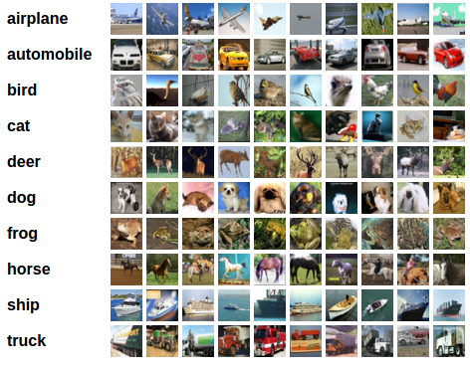
Image Classification
Label each image with one of several labels based on its contents

Slide 3
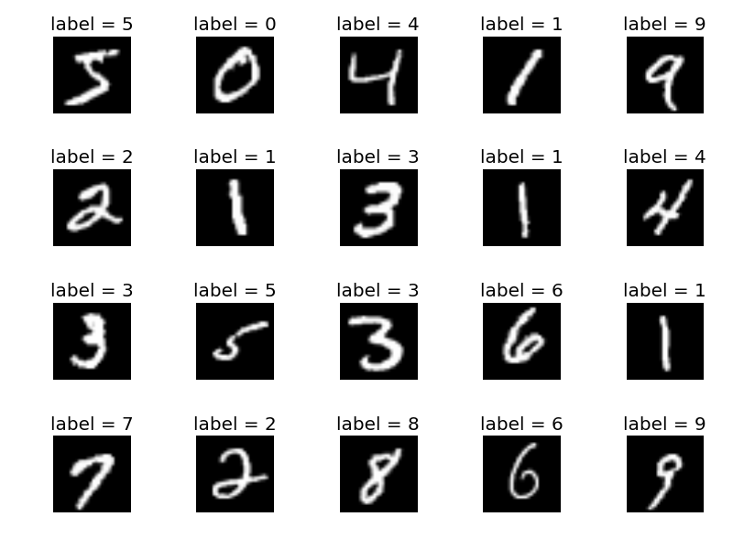
MNIST Dataset
Binary images of handwritten digits
60K training, 5K testing images

Slide 4
k-Nearest Neighbors
Simplest classification strategy
Compute distance of each test image from all training images
Find k training images with minimum distance
Choose label of the test image by majority voting among the labels of these k images

Slide 5
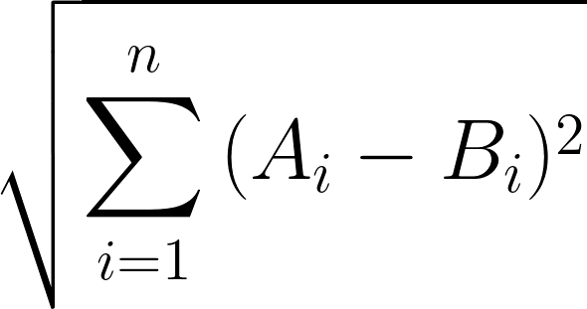
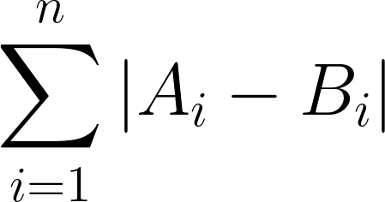
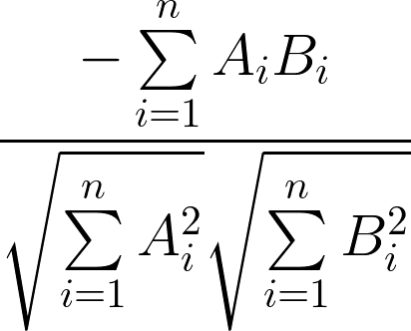
Distance Functions
Euclidean / L2 / Frobenius Distance
Manhattan / L1 Distance
Cosine Distance
Notes:
represent the two images with feature vectors A and B
simplest case – flatten the images → 28x28 MNIST images give 784 dimensional vectors, n=784
minus in cosine to convert similarity to distance

Slide 6
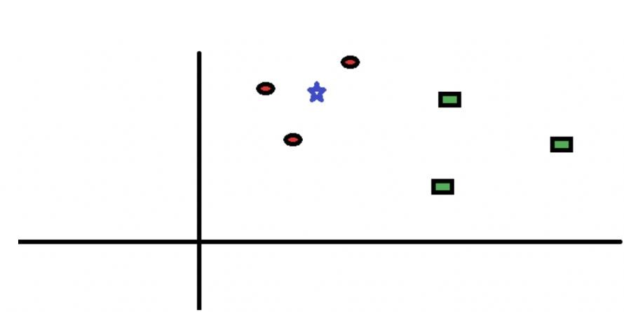
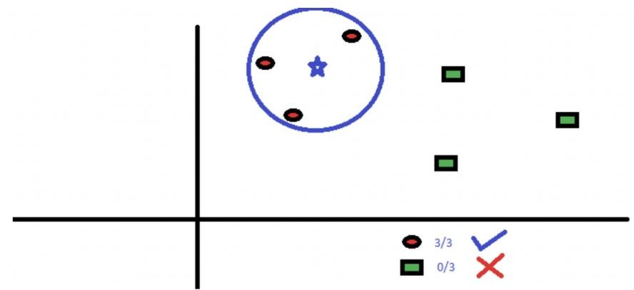

k-NN: How it Works
2 classes, 2D feature vectors, $k=3$
Class 1 Samples : Red Circles
Class 2 Samples : Green Squares
Test Sample: Blue Star

Slide 7
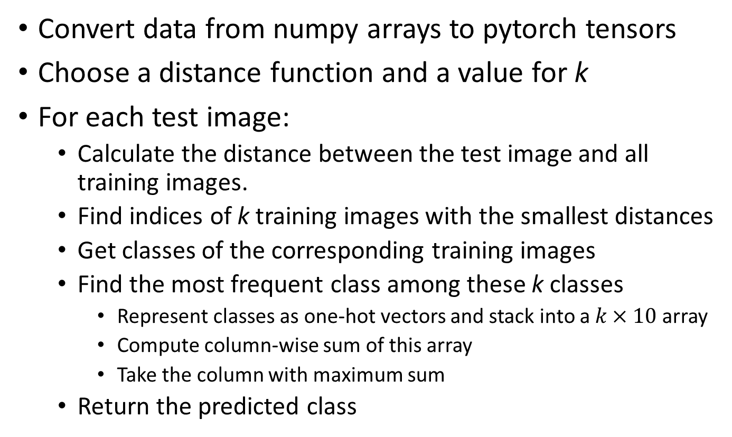
k-NN: How to implement
Convert data from numpy arrays to pytorch tensors
Choose a distance function and a value for k
For each test image:
Calculate the distance between the test image and all training images.
Find indices of k training images with the smallest distances
Get classes of the corresponding training images
Find the most frequent class among these k classes
Represent classes as one-hot vectors and stack into a $k×10$ array
Compute column-wise sum of this array
Take the column with maximum sum
Return the predicted class

Slide 8
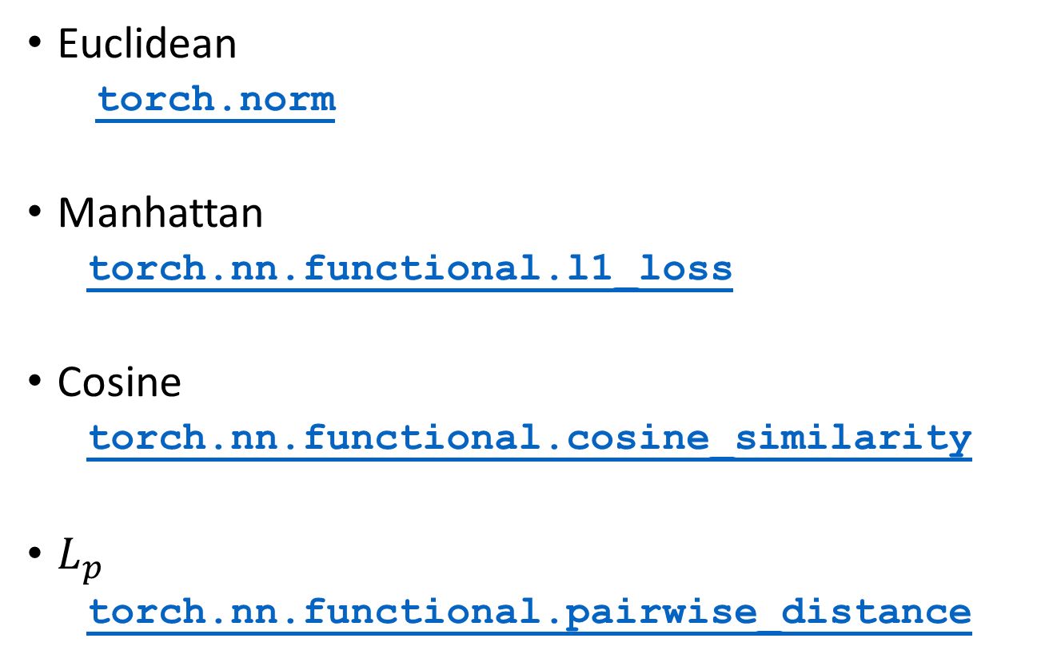
k-NN in PyTorch: Distance Functions
Euclidean
torch.norm
Manhattan
torch.nn.functional.l1_loss
Cosine
torch.nn.functional.cosine_similarity
$L_{p}$
torch.nn.functional.pairwise_distance

Slide 9
k-NN in PyTorch: Class Prediction
Find indices of k images with minimum distance
torch.topk
Get the corresponding classes
torch.gather (more info)
Find the most frequent class
torch.tensor.scatter (more info)
torch.sum
torch.argmax

